Slide 1
Continuity of Operations Exercise [Insert State Organization]
[Insert Exercise Date]

Slide 2
Welcome and Introductions
Opening Remarks
Housekeeping
Facility layout
Safety and security issues
Participant Roles and Responsibilities
Facilitator
Players
Evaluators
Observers

Slide 3
Agenda
[Update based on SitMan]
TIME | AGENDA ITEM
HH:MM | Participant Sign-In
HH:MM | Opening Remarks
HH:MM | Module 1: COOP Plan Phase 2 – Activation and Notification
HH:MM | Break
HH:MM | Module 2: COOP Plan Phase 3 – COOP Operations
HH:MM | Break
HH:MM | Optional Module 2A: COOP Plan Phase 3 (cont.) – Advanced COOP Operations [Delete if not applicable]
HH:MM | Break
HH:MM | Module 3: COOP Plan Phase 4 – Reconstitution
HH:MM | Exercise Hotwash
HH:MM | Closing Remarks and Adjournment

Slide 4
Exercise Information
[Insert images related to your Organization]

Slide 5
Objectives
Discuss and validate the State Organization’s COOP Plan elements, including:
Identification of Essential Functions/Critical Business Processes
Incident Management
Alternate Facilities
Critical Customers/Partners and Vendors
Resource Requirements
Discuss and validate the processes required to perform internal and external crisis communications.
Discuss and validate the process for reconstitution.

Slide 6
Guidelines
Maintain a low-stress, no-fault environment.
Do not fight the scenario.
Use your knowledge of your organization’s COOP plan.
Decisions are not precedent-setting.
Provide suggestions and recommended actions.
Problem-solving efforts should be the focus of the discussion.
Not every issue or problem can be discussed exhaustively.

Slide 7
Assumptions and Artificialities
Assumptions and artificialities are necessary to complete the exercise plan in the allotted amount of time.
Events in this scenario are fictional.
The scenario is plausible and is intended to drive discussion.
The scenario will not play out in real-time.
There is no hidden agenda; there are no trick questions.

Slide 8
Exercise Structure
Module 1 – COOP Plan Phase 2 – Activation and Notification
Facilitated Discussion
Module 2 – COOP Plan Phase 3- COOP Operations
Facilitated Discussion
Module 2A – COOP Plan Phase 3 (cont.) – Advanced COOP Operations [Delete if not applicable]
Facilitated Discussion
Module 3 – COOP Plan Phase 4 – Reconstitution
Facilitated Discussion
Hotwash

Slide 9
Evaluation
Evaluators will observe the exercise discussion and document findings and shared information in Exercise Evaluation Guides (EEGs).
At the conclusion of the exercise, participants will be asked to complete a Participant Feedback Form.
A Hotwash will be conducted to provide an opportunity for exercise participants to provide input, offer additional insights, and identify improvement actions.
The EEGs, Participant Feedback Forms, and Hotwash findings will be used to compile the After Action Report.

Slide 10
Exercise Scenario
[Insert images related to your Organization]

Slide 11
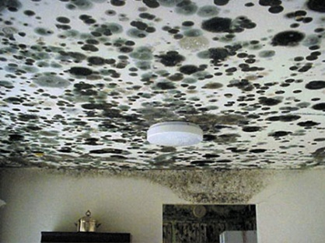
Mold Scenario
[Select scenario based on SitMan and delete other scenario slides. Incorporate additional images, if desired.]
For the past few weeks, an increasing number of employees have become ill with respiratory symptoms, including severe asthma, stuffy nose, wheezing, and red and itchy eyes.
Earlier today, while environmental clean-up crews were conducting an inspection, they discovered evidence of black mold.
Upon further inspection, extensive mold was observed throughout the length of the building’s HVAC system, on furniture, and within the wall insulation.
At [insert time of day or evening], leadership was notified that due to the extent of the mold and the health hazard it presents, the building must be vacated.
Personnel must prepare to activate their COOP Plan.

Slide 12
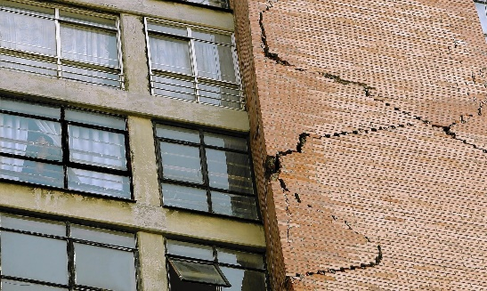
Earthquake Scenario
This morning at 11 a.m., employees experienced a sudden, strong shaking of the building that lasted for approximately 15 seconds. Recognizing an earthquake, employees took cover under desks and tables.
Books and equipment were thrown off shelves, some windows shattered, and [insert number] employees were injured.
Once the shaking stopped, employees observed large cracks in the building’s masonry. Due to the extent of the damage and the life safety hazard it presents, the building must be vacated.
Personnel must prepare to activate the COOP Plan.

Slide 13
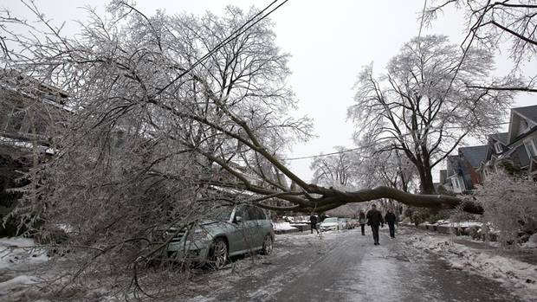
Winter Storm Scenario
Earlier this week, the National Weather Service (NWS) and local meteorologists predicted an incoming winter storm likely to deliver minimal to moderate snowfall. Forecasts indicate that the storm will not arrive until late this evening and will have little impact on commutes. Based on the forecast, employees of [Insert State Organization Name] report to work as usual.
Despite the forecast, heavy bands of snow, sleet, and freezing rain arrive at approximately 11 a.m. and begin to coat vehicles, trees, and power lines in snow and ice.
At 2 p.m., employees hear a loud crash, and the electricity goes out temporarily. The backup generator quickly restores basic lighting to the office. Moments later, it is reported that a large tree fell into the building. While no one was injured, the tree created a substantial hole in the roof and side wall and damaged office, file storage, and meeting space.
Due to the extent of the damage and the life safety hazard it presents, the building must be vacated. Personnel must prepare to activate their COOP Plan.

Slide 14
Module 1
[Insert images related to your Organization]
COOP Plan Phase 2 – Activation and Notification

Slide 15
Key Issues
Initial activation and notification of COOP procedures
Incident management
Critical customers/partners and vendors
Identification of essential functions/critical business processes and their dependencies
Resource requirements (vital records, equipment, software)

Slide 16
Discussion Questions
[Update questions based on SitMan]
What is the process for activating the COOP Plan?
Who can authorize the building closure?
How will staff be notified?
Would any other State organizations, vendors, or businesses be notified of your COOP Plan activation?
What critical vendors or coordinating entities will be notified?
How will external partners or customers be notified?
What essential functions/critical business processes are impacted?

Slide 17
Discussion Questions (continued)
[Update questions based on SitMan]
What software or critical applications are needed?
What vital records would potentially be unavailable?
What resources are required to ensure delivery of essential functions/critical business processes?
What equipment, procedures, guidance, and plans are included in the COOP Kit?
Who comprises the Damage Assessment Team?

Slide 18
Module 2
[Insert images related to your Organization]
COOP Plan Phase 3 – COOP Operations

Slide 19
Scenario Update
Organization leadership, in collaboration with building safety professionals, has determined that employees must relocate to the designated alternate facility for at least 30 days.

Slide 20
Key Issues
Alternate facilities
Resource requirements (software, equipment, finances)
Critical customers/partners and vendors

Slide 21
Discussion Questions
[Update questions based on SitMan]
Is an alternate facility identified?
What agreements are in place to occupy the alternate facility?
How will the alternate facility be set-up?
Are there any modifications that need to be made to the alternate facility prior to staff using it (e.g., additional office supplies, IT equipment)?
How long will it take for the alternate site to be active?
What essential functions/critical business processes will be delivered at the alternate facility?
How will the COOP Kit be accessed?
How will financial or accounting considerations at the alternate facility be handled?

Slide 22
Discussion Questions (continued)
How will personnel be accounted for?
What is the procedure for employees relocating to an alternate facility?
What is the process for transferring in-office assets to the alternate facility?
How will the primary facility remain secured?
How will staff access the alternate facility?
Are there any orientation materials provided to employees working at the alternate facility (e.g., parking restrictions, mass transit routes, local daycare centers, local eateries, etc.)?
Would telework be warranted/implemented?
Given the potential dispersal of employees between alternate facilities and telecommuting, how will routine communication be established?

Slide 23
Module 2A
[Insert images related to your Organization]
[Optional module]
COOP Plan Phase 3 (continued) – Advanced COOP Operations

Slide 24
Scenario Update
[Update with applicable scenario(s) based on SitMan. Delete unused updates and questions.]
Incident Command Changeover
An automobile accident has occurred that has incapacitated [insert the names of 2-3 leadership staff]. These individuals are not responding via cell phone.
Supply Chain Disruption
Due to labor strikes, DELL has been decreasing desktop and laptop production. Meanwhile, weather-related disasters have occurred in Maryland and New Jersey, which have resulted in increased demand for these products. You are unable to acquire additional computers at this time.
Network Disruption
Construction has been going on down the road from your alternate facility. At 11 a.m. five days into your relocation, your employees report that they are unable to connect to the state network. All internet activity is offline. Cisco phone lines are also offline, and personnel cannot be contacted at their work numbers. After one hour, you are informed that a fiber cut has occurred during the offsite construction, and it is estimated that it will take 36–72 hours for repairs to be completed.

Slide 25
Key Issues
Identifying, authorizing, and initiating lines of succession
Manual work-around procedures
Alternate vendors/supply management

Slide 26
Discussion Questions
[Update questions based on selected scenario(s). Delete unused questions.]
Incident Command Changeover
What are the potential impacts if the missing personnel cannot be located?
Are lines of succession in place?
What are the parameters for initiating succession actions?
Who can authorize them?
Do the procedures or authorizations change if someone is killed vs. injured, perhaps severely?
Would these considerations be different for an elected official? [May not be applicable to all State Organizations – delete if not applicable.]
In the absence of key personnel, how will decisions be authorized?

Slide 27
Discussion Questions
[Update questions based on selected scenario(s). Delete unused questions.]
Supply Chain Disruption
What resources are available at the alternate location?
Who is authorized to make resource purchases or leasing decisions?
How quickly can resources be procured?
What vendors will be used to obtain resources?
How will vendors be contacted?
If primary vendors are unavailable, how will resources be acquired?
What work-around options are available for performing critical business processes with limited resources?
How will employees be informed about limited resources or updated procedures?

Slide 28
Discussion Questions
[Update questions based on selected scenario(s). Deleted unused questions.]
Network Disruption
What management decisions are being made as a result of this situation?
Who will be contacted regarding this situation?
How will critical processes be performed if network access is down?
How will staff be notified of the situation?
Will any information be communicated to the public?
What partners are you working with to mitigate or resolve the situation?

Slide 29
Module 3
[Insert images related to your Organization]
COOP Plan Phase 4 – Reconstitution

Slide 30
Scenario Update
It has been 15 days since the incident, and personnel are operating from the alternate location(s)/teleworking.
Leadership was just notified that repairs will be more extensive than initially believed. Estimates indicate that the primary building will be closed for an additional 45–60 days.
Staff identify that supplemental equipment will be needed to replace worn or damaged equipment.

Slide 31
Key Issues
Long-term leasing and operational considerations
Recovery tracking and communication

Slide 32
Discussion Questions
Who will approve purchases during COOP operations?
What is the process for acquiring additional supplies during COOP operations?
Does the extended timeframe trigger any alternate facility leasing requirements?
Using the options identified in the COOP Plan, describe the process of recovery and how progress will be tracked.
How will employee impacts (e.g., psychological) be addressed?
Will an extended relocation impact essential functions/critical business processes?
What is the process for updating the COOP Plan based on observations from this incident?

Slide 33
Participant Feedback and Hotwash
[Insert images related to your Organization]

Slide 34
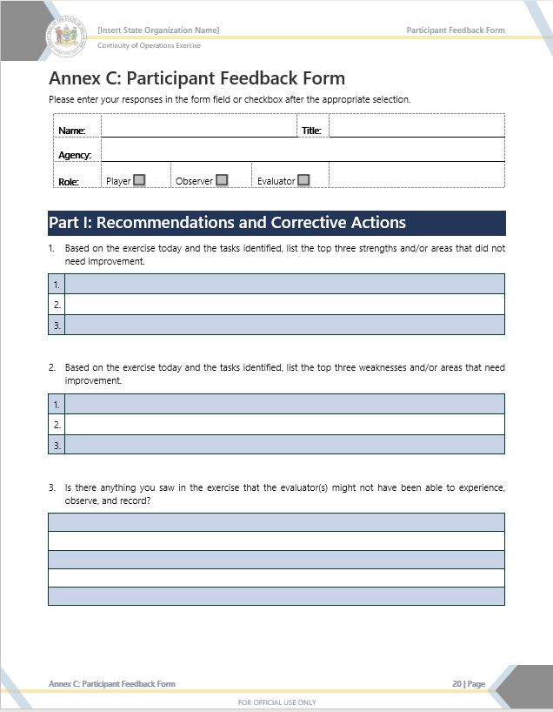
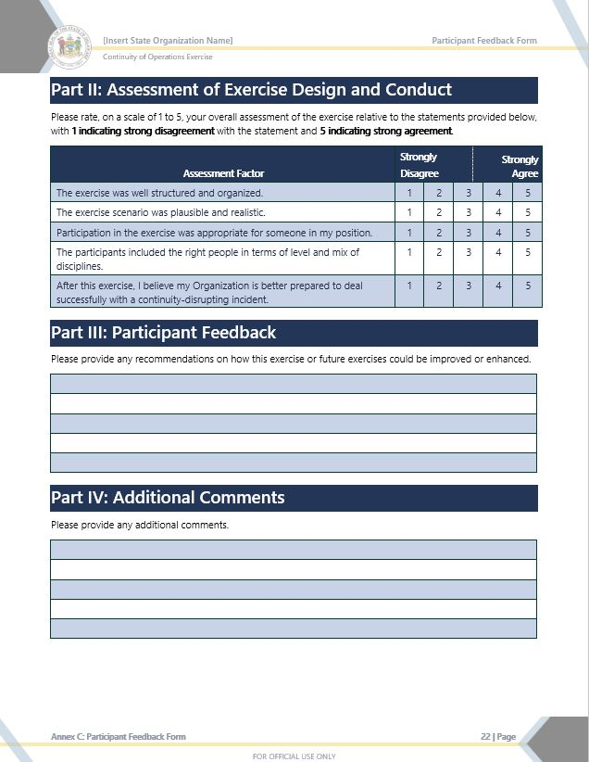
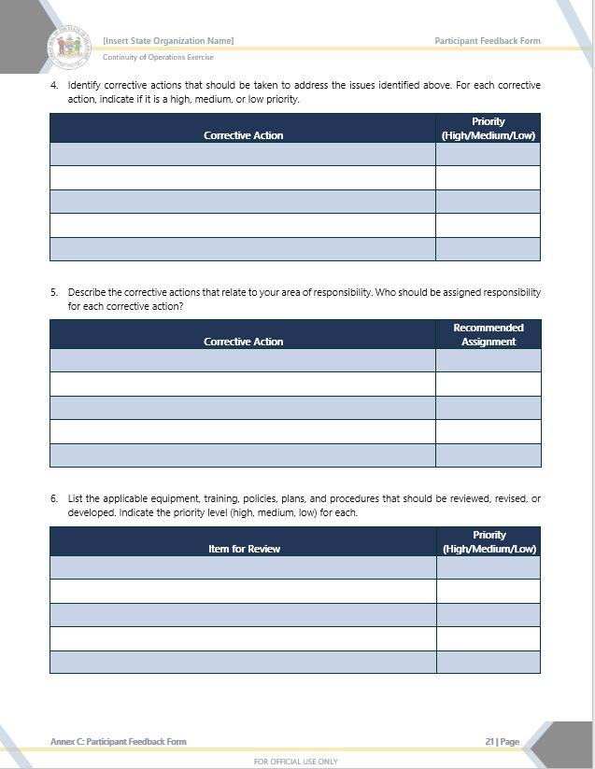
Participant Feedback Forms
Please return your Participant Feedback Forms to the facilitator before leaving

Slide 35
Exercise Hotwash
What strengths were identified in the COOP Plan?
What are the improvement opportunities for the COOP Plan?
What gaps were identified in the COOP Plan?
What are the high-priority issues that should be addressed?
What new ideas and recommendations are there for improving exercises?

Slide 36
Thank you for your participation!

